Slide 1
Density dependence The dependence of a per capita life history parameter on population size or density
Vandermeer and Goldberg p7-19; p28-29

Slide 2
Continuous time
Logistic growth model can be derived assuming
r is proportional to food available
Food available is proportional to population size
See vandermeer and Goldberg p. 14-17

Slide 3
Logistic growth (continuous time)
r: intrinsic growth rate at low population size (1/time)
K: carrying capacity (number)
N(t): size of the population at time, t.

Slide 4
Equilibrium points
Values of N(t) such that
Equilbria can be unstable
Stability of equlibrium can be determined by a line-arrow diagram

Slide 5
Logistic growth (continuous time)
N(t) = 0 is stable when r < 0
N(t) = K is stable when r > 0
Per capita growth rate decreases linearly

Slide 6
Logistic growth (discrete time)
As from p28 vandermeer and Goldberg. This model has historical significance, but..
… this is a poor population model because population size can be negative:
i.e. find N₁ and N₂ for N₀ = 70, K = 100, and λ=5
K is not the carrying capacity for this model: the positive equilibrium is K(λ-1)/λ
Turchin: Complex Population Dynamics has a good discussion of discrete time models with density dependence

Slide 7
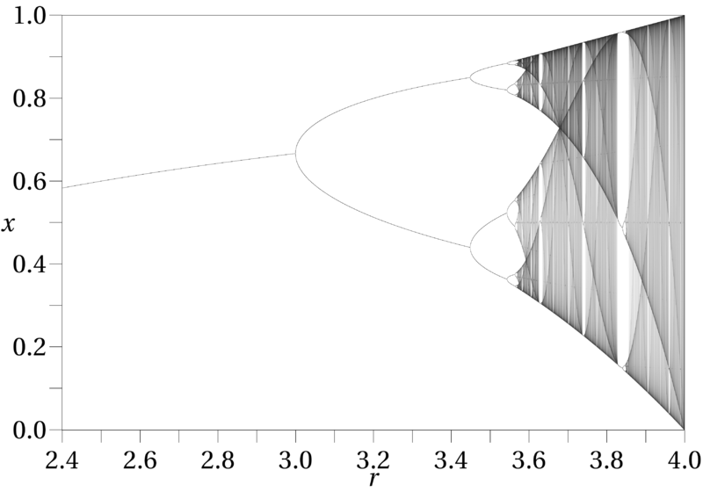

Slide 8
Logistic growth (discrete time)
K is the carrying capacity, but negative values are still possible

Slide 9
Density dependence for discrete time models of population growth
Beverton-Holt
Logistic
Ricker

Slide 10
Logistic map dynamics
Notes:
X_{t+1} = rX_t*(1-X_t/K)
Top (L-R): r=2.7, r=3.4.
Bottom (L-R): 3.8, 0.5

Slide 11
Ricker model dynamics

Slide 12
Beverton-Holt model dynamics

Slide 13
Models | Dynamics
Geometric (DT exponential) | a
CT exponential | a
CT logistic growth | a,b
Alternative DT logistic map | a,b,c,d
Ricker | a,b,c,d
Beverton-Holt | a,b
a. Equilibrium at 0; b. Equilibrium at K;
c. Periodic cycles; d. Chaos

Slide 14
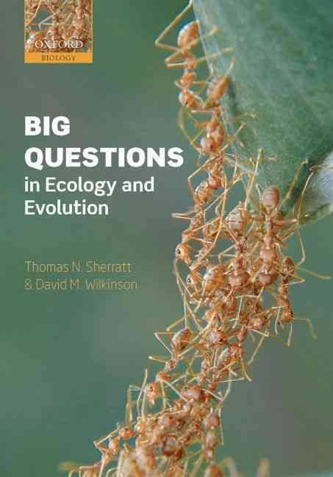
Do biological populations exhibit chaotic dynamics?

Slide 15
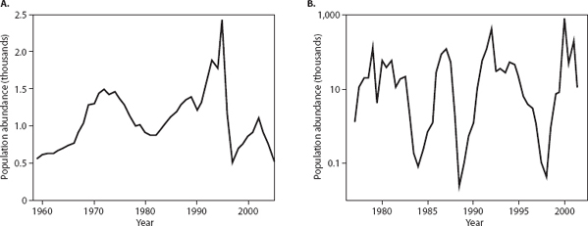
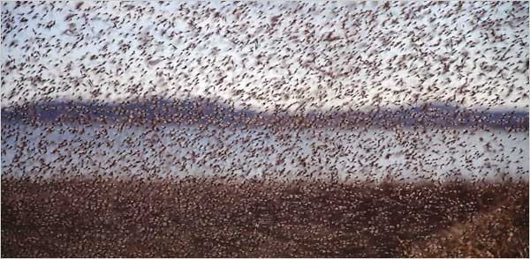
How to identify chaos?
The midge Tanytarsus gracilentus in Lake Myvatn, Iceland
Photo credit: Kenneth Chang
Notes:
Stochasticity.

Slide 16
Definition of chaos
‘a trajectory is chaotic if it is bounded in magnitude, neither periodic or approaches a periodic state, and is sensitive to initial conditions’ Cushing et al. 2002. Chaos in ecology. Academic Press.
Extreme sensitivity to initial conditions – butterfly effect
Notes:
Edward Lorenz, meterologist. If weather systems were chaotic then an almost negilible change in local wind speed in South America, such as that created by the wing flap of a butterfly, may ultimately be the difference between having or not having a hurrican in the Northern hemisphere.

Slide 17
Initial population size N₀ = 1
Initial population size N₀ = 1.01
Ricker model: r = 3.5, K=20

Slide 18
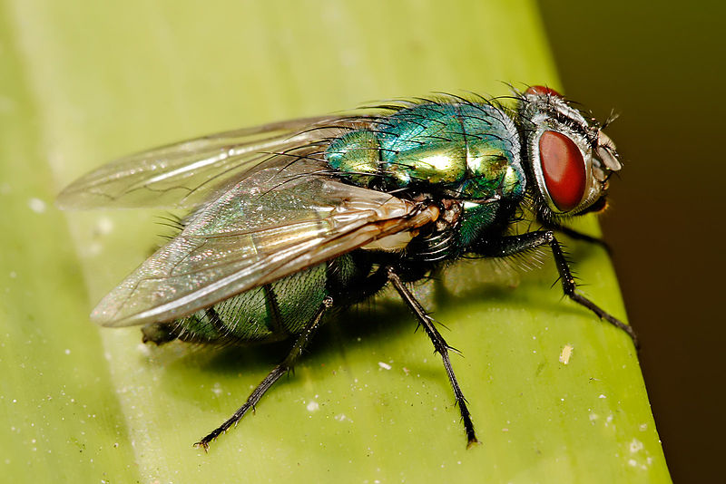
Photo credit: Fir0002/Flagstaffotos

Slide 19
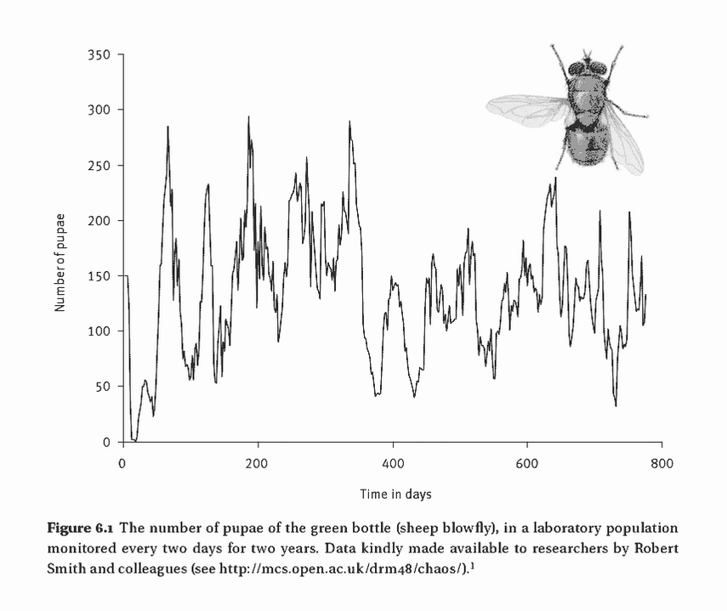

Slide 20

28 insect data sets
Only the laboratory study of blowflies by Nicholson had parameters in the chaotic regime
Could be a laboratory artifact: not subject to natural mortality from parasitic wasps

Slide 21
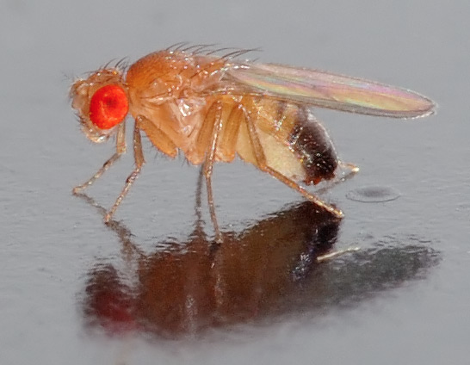
Photo credit: Andre Karwath
27 (Thomas et al. 1980) and 25 (Mueller and Ayala 1991) genetically distinct fruit fly populations
No evidence of chaos

Slide 22
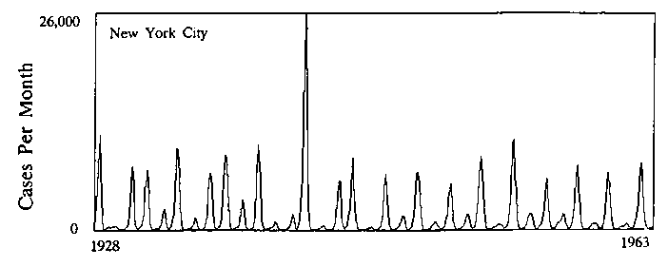
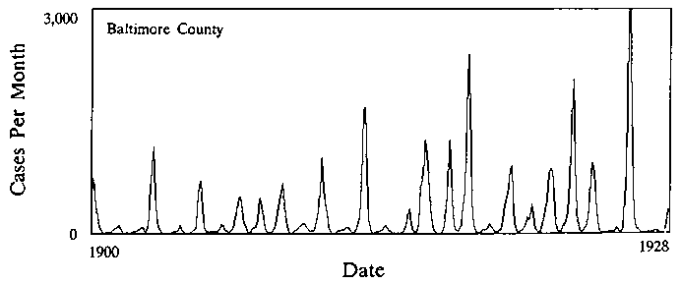
Source: Hedrich (1933)
Measles in NYC and Baltimore, 1928-1963
Analyses find the dynamics are chaotic
Doubts: birth rates have changed over time, amount of seasonal forcing required to generate chaos more than observed
Notes:
41- 43

Slide 23
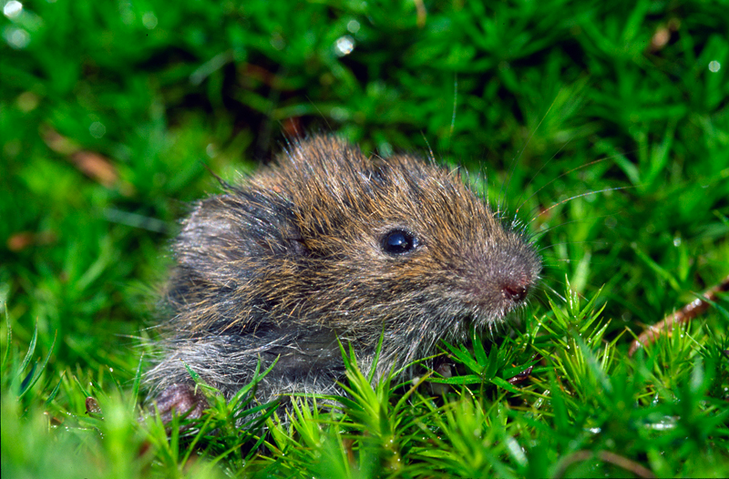
Photo credit: Fer boei
Microtus voles in western Finland
Time series shows ‘chaos superimposed’ on top of a more regular signal.
Notes:
Hanski et al. 55

Slide 24
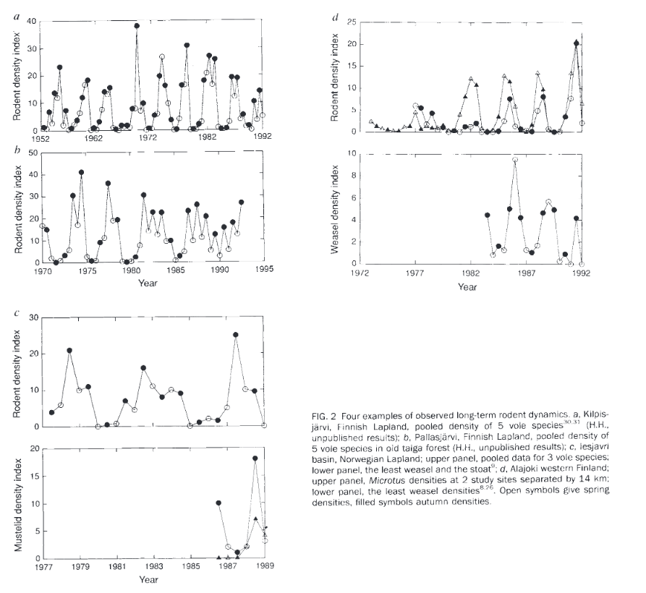
Since 1984, 3 yr cycles
Multiannual cycles absent since 1980
Hanski et al. 1993 Nature

Slide 25
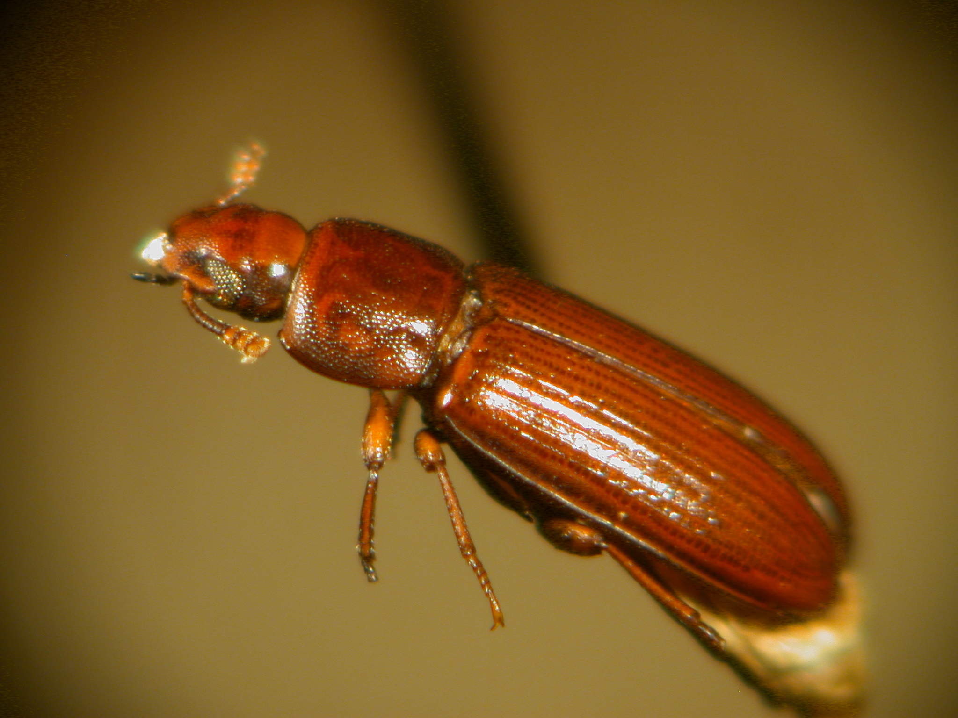
Flour beetles (Tribolium castaneum)
Artificially manipulated adult mortality and the pupae to adult recruitment rate to generate chaos
Criticism: forced the system to match the model not other way around

Slide 26
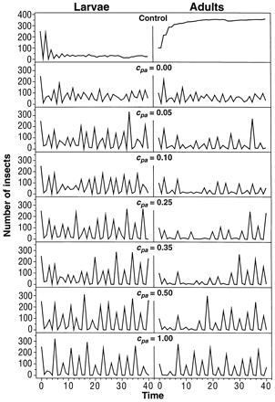
Equilibrium
chaos
period-3 cycle
Costantino et al. 1997

Slide 27
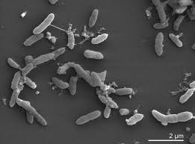
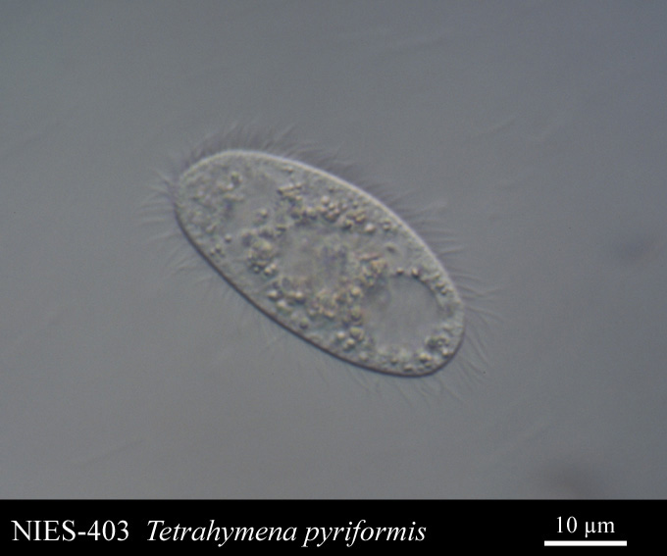
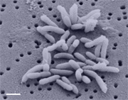
Pedobacter
Source: http://bacmap.wishartlab.com/organisms/937
Brevundimonas
Source: https://microbewiki.kenyon.edu/index.php/Brevundimonas_diminuta
source: www8.umoncton.ca
Laboratory experiments with bacteria-eating ciliate predator and two species of bacteria
Evidence of chaotic dynamics
Notes:
Becks and colleagues 61

Slide 28
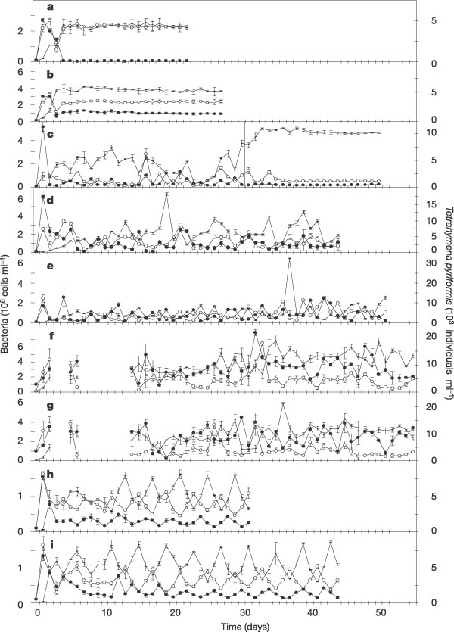
Source: Becks et al. 2005. Nature.
Notes:
Dilution rates D were as follows: a, 0.90 d⁻¹, b, 0.75 d⁻¹; c, 0.50 d⁻¹ (the line indicates the change to 0.75 d⁻¹ at day 30); d−g, 0.50 d⁻¹ (replicate experiments; no sampling took place on days 3, 4 and 7−13 in f and g); h, i, 0.45 d⁻¹ (replicate experiments). Open circles, Pedobacter (preferred prey); filled circles, Brevundimonas (less-preferred prey); horizontal bar, Tetrahymena (predator). Vertical bars represent the s.d. of triplicate samples taken separately from one chemostat.

Slide 29
Summary
“we cannot rule out the possibility … [of chaos in nature] …but the case is looking increasingly shaky, at least for multicellular organisms.
Data sets are short term and noisy.
Notes:
Becks and colleagues 61

